Slide 1
Secure data hiding in image using steganography
CAPSTONE PROJECT
Presented By: JEEVA E
Student Name : JEEVA E
College Name & Department : M.Kumarsamy College Of Engineering & Electronics and Communication Engineering

Slide 2
OUTLINE
Problem Statement
Technology used
Wow factor
End users
Result
Conclusion
Git-hub Link

Slide 3
Problem Statement
As more sensitive data is shared over digital platforms, ensuring data security has grown in importance. Hidden communication is essential as hackers are drawn to traditional encryption methods. As such, this project proposes a secure and efficient algorithm for image steganography to conceal credit information inside of images without degrading quality.

Slide 4
Technology used
Language: Python
Platform: Windows
Libraries Used
Image Processing:
OpenCV – Used for image manipulation and pre processing
PIL (Pillow) — To deal with various image types
Steganography Techniques:
Stegano – To perform LSB (Least Significant Bit) steganography
Handle Data & More:
NumPy – To deal with pixel arrays efficiently
Matplotlib – For visualizing how the images change

Slide 5
Wow factors
Two Defense Mechanism – Uses steganography with AES encryption to provide two layers of protection.
Adaptive Steganography – Employs data-aware pixel selection to conceal information in intricate areas of the image, increasing the difficulty of detection.
High Imperceptibility – Preserves image quality (PSNR & SSIM) the hidden data is imperceptible to human vision.
User-friendly Interface – Ability to be used as a desktop app (Tkinter) or web app (Flask/Django)

Slide 6
End users
Whistle-blowers, journalists and others requiring access to sensitive information
Professionals for secure data exchange — Cybersecurity
Businesses that deal with sensitive contracts and intellectual property

Slide 7
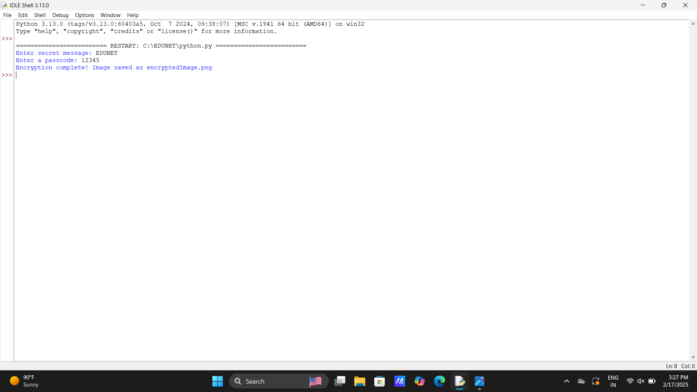
Results

Slide 8
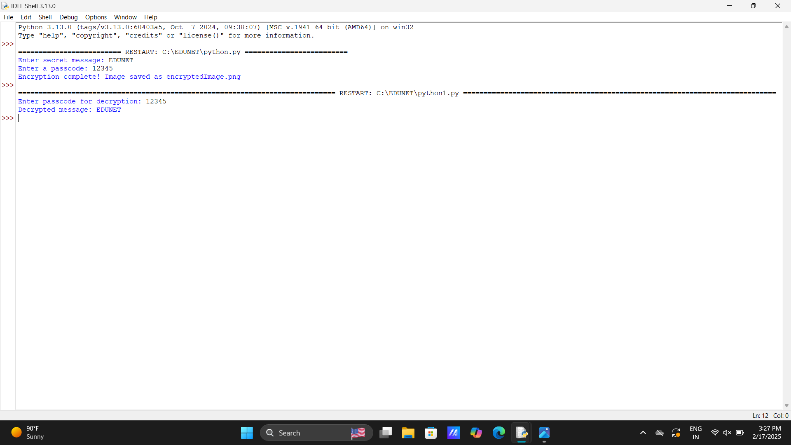

Slide 9


Slide 10
Conclusion
The project Image Steganography With Encryption implements the solution for data transmission in a secure manner. It embeds data into images in a non-detectable manner, employing advanced encryption standard (AES) encryption to provide confidentiality, integrity, and stealth from steganalysis. They use the solution that is the lightweight, scalable, and cross-platform solution for secure communications in microservices architecture applications.

Slide 11
GitHub Link
https://github.com/Jeeva-1405/Edunet/tree/main

Slide 12
THANK YOU

